Slide 1
Unit 1.Part II. Access XML with SAX

Slide 2
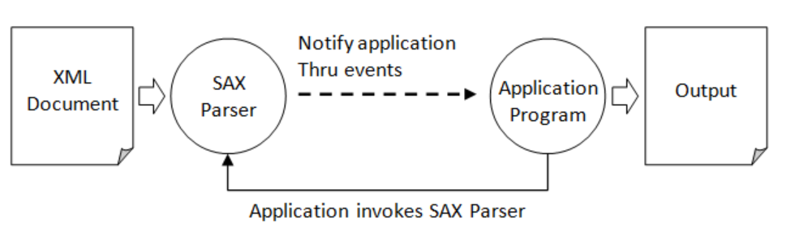
SAX: Simple API for XML
Ntu.edu.sg: example from it
SAX is an event-driven API. The SAX API defines a number of callback methods, which will be called when events occur during parsing. The SAX parser reads an XML document and generate events as it finds elements, attributes, or data in the document. There are events for document start, document end, element start-tags, element end-tags, attributes, text context, entities, processing instructions, comments and others.

Slide 3
SAX parser
JDK provides a SAX parser (called SAXParser) in package javax.xml.parsers.
To use the SAXParser, you need to create a SAXParserFactory, and then obtain a SAXParser from the factory. You can then use the parse() method to parse an XML document.
The parse() methods requires two arguments:
the XML document to be parsed (in File, InputStream, InputSource, or as a String),
a callback handler.

Slide 4
SAX events
SAX is an event-driven API. It defines a set of callback handler methods that will be invoked when events occur during parsing. JDK provides a DefaultHandler class (in package org.xml.sax.helpers). You can subclass this DefaultHandler and override the callback handler methods to implement your programming logic.
The commonly-used callback methods are:
// Callback to handle the start/end of the document:
void startDocument()
void endDocument()
// Callback to handle the element start/end tag:
void startElement(String uri, String localName, String qName, Attributes attributes)
void endElement(String uri, String localName, String qName)
// Callback to handle the data inside an element:
void characters(char[] chars, int start, int length)

Slide 5
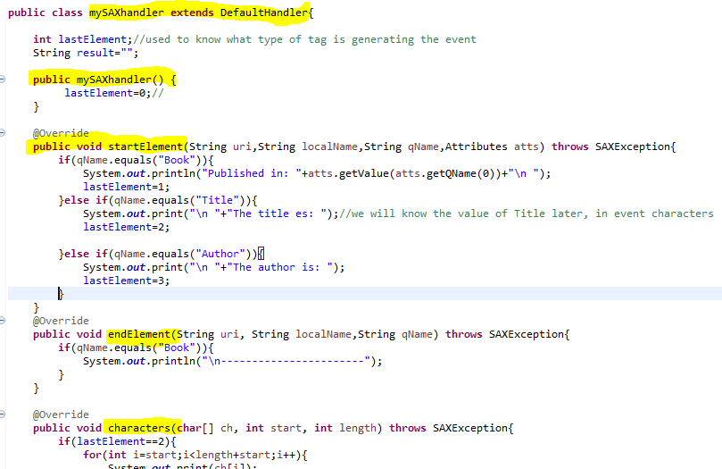
Defining our sax handler

Slide 6
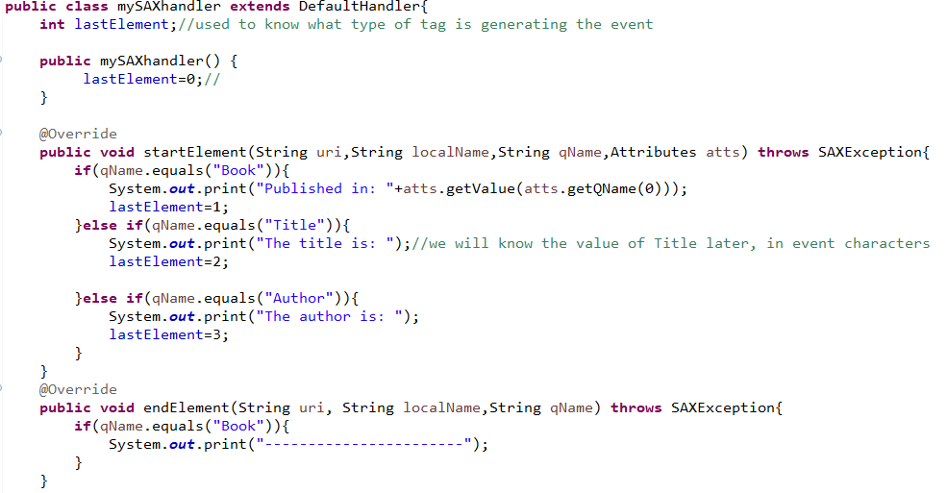
Practice 5: sax(see document)
Create MySAXHandler

Slide 7
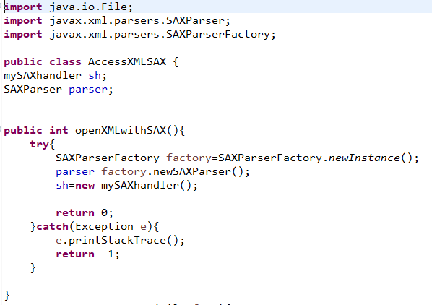

Slide 8
Jaxb.
See Unit 1- part III

